Slide 1
Comparative Analysis of the Top 100 Best Books of the 21st Century
Using Web Scraping and Data Visualization
Siddhi Dhuri

Slide 2
Problem Statement
With the increasing availability of multiple book ranking and rating platforms such as Amazon, Flipkart, Goodreads, and critic-based lists like NYT and The Guardian, there exists significant variation in how books are evaluated across platforms. This study aims to analyze and compare these differences using statistical methods, focusing on rating discrepancies, rank variations, and platform-wise preferences. The objective is to identify whether reader-driven platforms and critic-driven rankings align, and to understand the extent of disagreement, consistency, and bias across different systems.

Slide 3
Data Sources
Amazon, Flipkart, Goodreads
The New York Times, The Guardian, Reader’s Digest
Data fields: title, author, genre, publisher, rating/rank, country, year

Slide 4
Research Methodology
Data collected using web scraping
Data cleaned and standardized
Comparative analysis (ratings vs ratings, rankings vs rankings)
Insights presented using charts and dashboards
Dataset Link

Slide 5
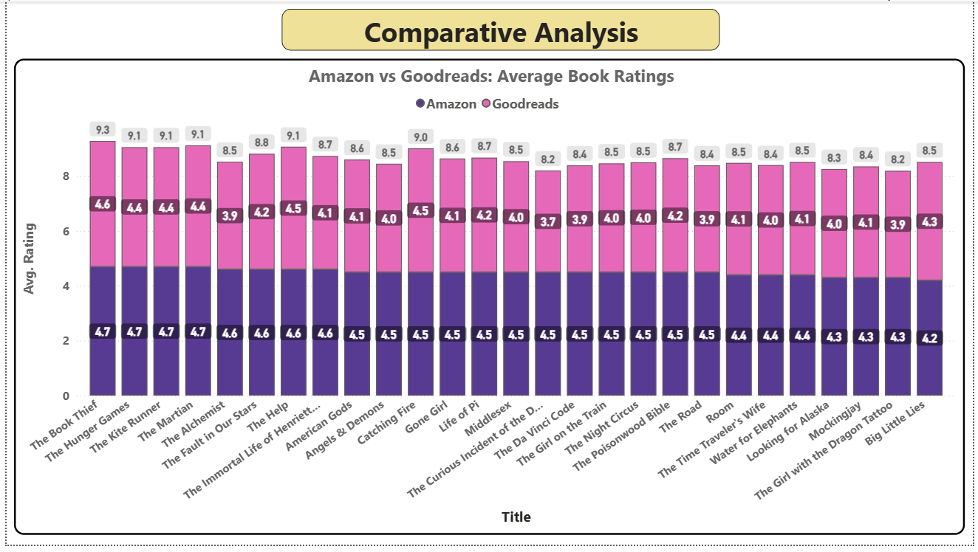
Comparative Analysis’ Insights
Chart 1: Amazon vs Goodreads – Detailed Comparative Ratings
What it shows: Ratings for many books across both platforms.
Insights:
Amazon ratings cluster tightly between 4.3–4.7, showing rating inflation.
Goodreads ratings vary more, proving it captures true community opinion rather than consumer excitement.
Books like The Book Thief and The Hunger Games are highly praised on both platforms → universally accepted favourites.
Books with bigger differences like The Immortal Life of Henrietta Lacks indicate that Goodreads readers scrutinize themes and depth more critically.
Conclusion: Amazon reflects purchase satisfaction, while Goodreads reflects literary judgement.

Slide 6
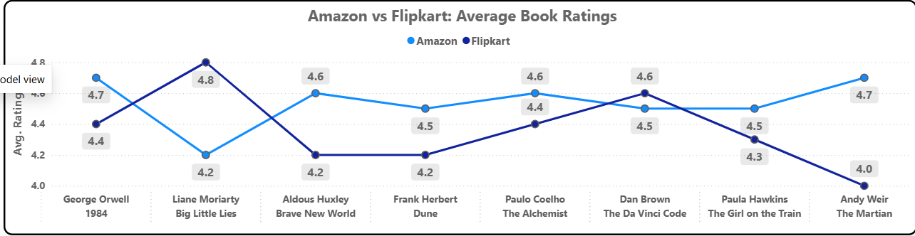
Comparative Analysis’ Insights
Chart 2: Amazon vs Flipkart – Line Comparison
Insights:
Ratings intersect multiple times, indicating no consistent agreement.
Big Little Lies has highest Flipkart rating but one of the lowest Amazon ratings → Indian users resonate with it more.
The Martian shows the opposite — Amazon users love it far more than Flipkart.
Conclusion: Goodreads vs Flipkart – Detailed Comparative Ratings Regional audience tastes differ significantly by genre and theme.

Slide 7
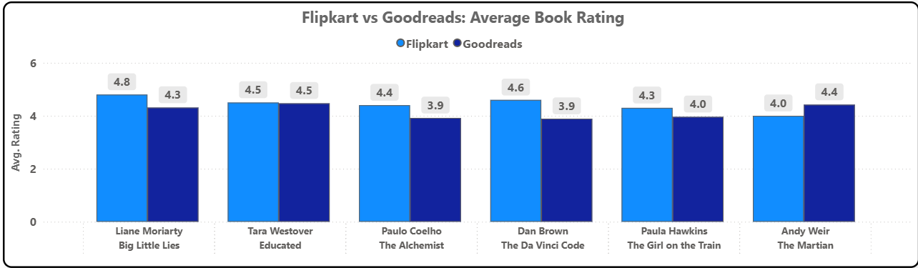
Comparative Analysis’ Insights
Chart 3: Goodreads vs Flipkart – Detailed Comparative Ratings
Insights:
Flipkart tends to score books slightly higher than Goodreads here.
Goodreads users rate more critically, especially for Dan Brown and Paulo Coelho — popular authors, but not critically revered.
Educated and Big Little Lies have consistently high ratings across both platforms → strong narrative resonance.
Conclusion: Goodreads = critical depth, Flipkart = popular sentiment.

Slide 8
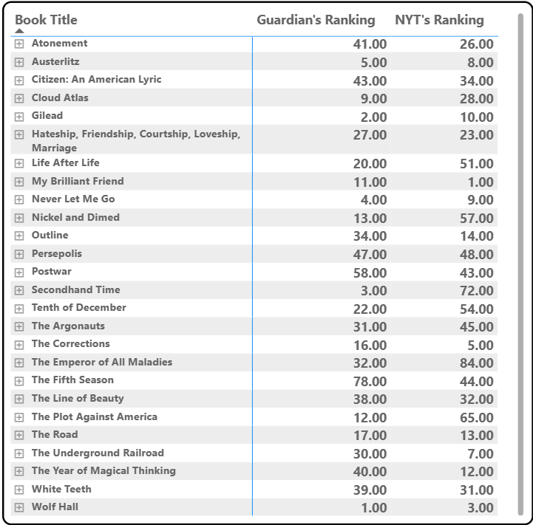
Comparative Analysis’ Insights
Chart 4: The Guardian vs NYT Rankings
Insights:
Large rank differences show disagreement Books with big positive differences = NYT liked them much more than The Guardian Books with big negative differences = The Guardian rated them higher than NYT.
• Presence of both small and large differences indicates:
Some books have universal acceptance
Many books have platform-specific popularity
• The matrix shows critics vs. audience taste conflict very clearly.

Slide 9
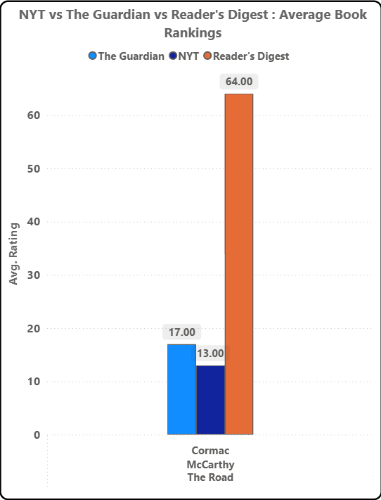
Comparative Analysis’ Insights
Chart 5: Guardian vs NYT vs Reader’s Digest Rankings (The Road)
Insights:
The Guardian ranks The Road at 17, NYT ranks it even better at 13 → critics highly value it.
Reader’s Digest ranks it at 64 → general readers do not rate it as highly.
This shows a massive perception gap: Critics love serious, literary themes, while readers prefer engaging, emotional, or popular narratives.
Conclusion: Critical acclaim ≠ mainstream appeal. High-quality literature may not always be commercially adored.

Slide 10
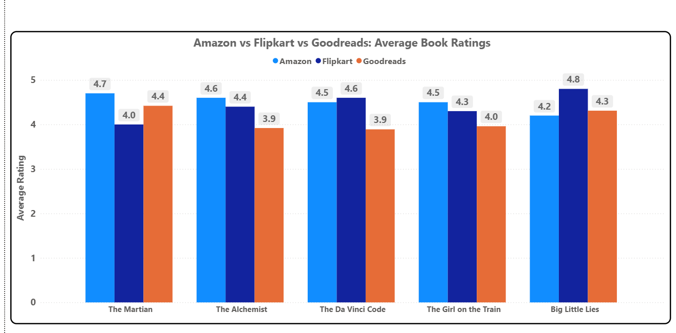
Comparative Analysis’ Insights
Chart 6: Amazon vs Flipkart vs Goodreads – Average Ratings
What it shows: 5 popular books rated across 3 platforms.
Insights:
Amazon consistently gives the highest ratings, indicating a more generous rating culture.
Flipkart ratings are the lowest among the three for every book → Indian audience appears more critical.
Goodreads ratings sit in the middle → balanced, community-driven evaluation.
The Martian has the largest rating gap (Amazon 4.7 vs Flipkart 4.0), showing regional perception differences.
The Alchemist shows the smallest spread → universally liked across platforms.
Conclusion: Reader perception varies across markets — Amazon users show more positivity, while Flipkart readers are more judgemental.

Slide 11
Conclusion
Reader perception of books varies significantly across platforms. Amazon users rate more positively, Flipkart users are stricter and regionally influenced, while Goodreads offers the most balanced and community-driven review system. Critic-based rankings (Guardian/NYT) often diverge sharply from Reader’s Digest and commercial ratings, proving that critical acclaim does not guarantee popular acceptance. Only a handful of books achieve universal appreciation across both expert and public platforms.

Slide 12
Future Scope
Social Relevance
Helps readers make informed choices
Reveals bias in popular book lists
Promotes data-driven thinking in literature
Sentiment analysis of reader reviews
Inclusion of regional and non-English literature
Machine learning-based recommendation systems

